Slide 1
Module 2: Lesson 4 Cloud Object Storage for Big Data

Slide 2
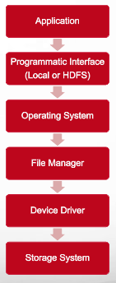
First Let’s Think of File Systems
When you access a file system you must do so through a server or virtual machine running an operating system
So file storage, operating system and compute capability are all coupled together to some degree
For example, the Linux file system is organized differently to that provided via MS Windows
And that means that Windows files can only be read if you have an active Windows machine (or translation software)
The storage systems that file systems are built over CAN be expanded to files of almost and size
But this requires costly hardware along with operational maintenance, and capability for backup and restore

Slide 3
Now Let’s Think About the Internet
You can retrieve a pdf document, a music or video file, a web page, an image, and so forth
Consider the providers of this content as offering storage services holding content until you request it
And the interface to these services is the HTTP protocol: GET content, PUT content, etc.
These services are file system interface and operating system independent and leave it to the requestor to interpret the stored content
And the requestor does not care through what means or where the content was stored

Slide 4
Let’s Think More About the Internet
There is no notion of directories or subdirectories, just a host name and a path to the content of interest
http://www.somehostname.com/documents/grades.pdf
The host name is the name of a container for content
/www.somehostname.com
The path identifies (uniquely names) the specific content item
documents/grades.pdf
And the interface to these services is via a standard Internet (HTTP) protocol

Slide 5
From the Internet to Cloud Object Stores
What if we were able to provide storage of content
independent of servers, operating systems and file systems?
What if we made this storage available as a service over the Internet?
What is this service could store terabytes to petabytes of data?
Then we would have a
Cloud Object Store
What is this service was highly available, very durable, secure?
Oh, and what if it was cost effective, too?

Slide 6
What is a Cloud Object Store
Managed cloud data storage service accessible from the Internet
Objects can be grouped into collections, each having a unique name
An object is data (a sequence of bytes) tagged with a unique identifier and associated with some metadata
Collections hold objects only and not other nested collections (think no sub-directories)
http/https

Slide 7
What is a Cloud Object Store
Designed to handle massive volumes of data
Employs redundancy and replication mechanisms to safeguard data against hardware failures, network outages, and other disruptions
Ideal for large datasets that don’t change very often or that have a lot of associated metadata
Offers a cost-effective solution, as organizations only pay for the storage they consume

Slide 8
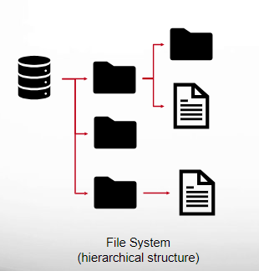
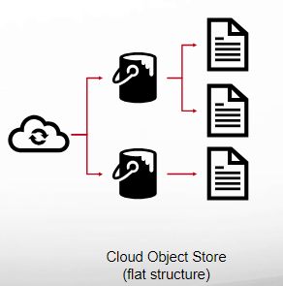
File System Versus Cloud Object Store

Slide 9



Cloud Object Storage Providers
Google Cloud Platform (GCP)
Google Cloud Storage
All services offer a pay-as-you-go models, support essentially unlimited amounts of storage, and provide various storage tiers to suit different needs
Microsoft Azure
Microsoft Azure Blob Storage
All services offer flexible pricing, based on storage capacity, data transfer, and storage tier, enables businesses to optimize costs according to their specific requirements
Amazon Web Service (AWS)
Simple Storage Service (S3)

Slide 10
Amazon S3 Summary
Simple Storage Service
Secure, durable, highly-scalable object storage
Accessible via a simple web services interface
Store and retrieve any amount of data
Use alone or together with other AWS services
Including AWS EMR (AWS’s Hadoop service)

Slide 11
Amazon Simple Storage Service (S3) Overview
The development of S3 stemmed from Amazon’s internal need for a scalable and reliable cloud storage service
Launched in March 2006 and has undergone continuous development and enhancement
Designed for up to 99.999999999% durability
If you store 1 million objects for 10 million years, you would expect to lose 1
Designed for up to 99.99% availability over a given year
52 minutes and 36 seconds of downtime per year

Slide 12
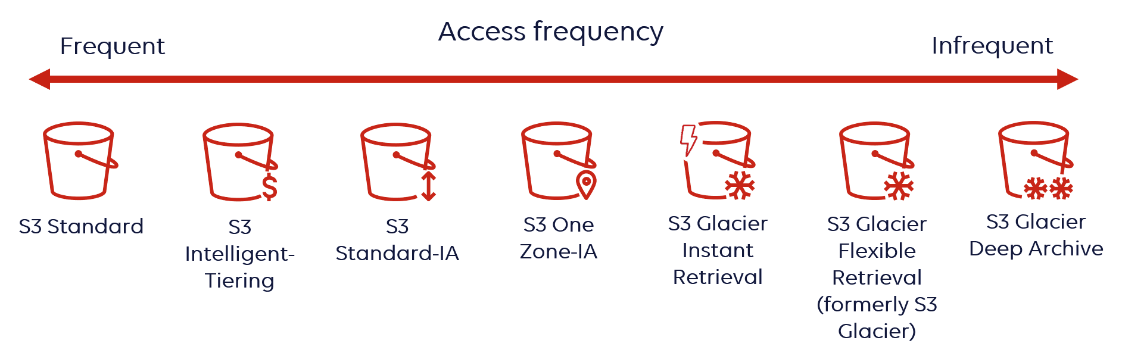
Amazon Simple Storage Service (S3) Overview
Provides different levels of reliability and availability through storage tiers
S3 Intelligent-Tiering is a storage class designed to optimize storage costs by automatically moving data to the most cost-effective access tier

Slide 13
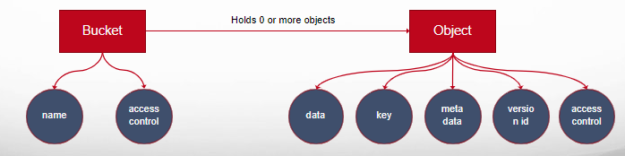
Amazon S3 Concepts Buckets
Containers for objects stored in S3
Organizes the Amazon S3 namespace
at the highest level
Has a name unique across all AWS accounts
Buckets hold objects only and not other buckets
(flat namespace)

Slide 14
Amazon S3 Concepts Object
The fundamental entities stored in S3
Objects consist of object data and metadata. The metadata is a set of name-value pairs that describe the object
Is uniquely identified within a bucket by a key (name) and a version ID (if S3 Versioning is enabled on the bucket)
An object may be no more than 5 TB in size and once written contents cannot be modified, deleted or even appended to

Slide 15
Benefits of Cloud Object Storage
Hadoop Integration
Accessible through implementations of the Java abstract class org.apache.hadoop.fs.FileSystem using schemes s3:// or s3a://
Data Lifecycle Management
Automated policies for archiving, backup, and deletion of data
Enhanced Data Security
Robust access controls, encryption, and compliance features to protect sensitive dat.
Cost-Effective Data Storage
Pay-as-you-go pricing models and tiered storage options to optimize costs
Enhanced Scalability
Allows users to store vast amounts of data without worrying about capacity limitations

Slide 16
Benefits of Cloud Object Storage
Elevated Availability and Durability
Replicates data across multiple data centers to ensure protection against hardware failures or natural disasters
Ease of Use
Simple APIs and intuitive interfaces simplify data management.
Simplified Data Management
Eliminates the need for users to manage storage infrastructure offering a service where storage
concerns become the domain of the cloud provider
Enhanced Data Sharing
Users can easily access and share data from anywhere with an internet connection, promoting collaboration and efficiency
Future-Proof Storage Solution
Cloud object storage is a constantly evolving technology, with regular updates and enhancements

Slide 17
Limitations of Cloud Object Storage
Write Once Semantics
Once written, object contents cannot be modified, deleted or even appended to, making this storage inappropriate for (transactional) applications with frequently changing data
Vendor Lock-in
Choosing a cloud storage provider can lead to vendor lock-in, making it difficult or costly to switch to a different provider in the future. Proprietary data formats and APIs can make it challenging to migrate data to another platform
Internet Connectivity
Cloud object storage requires a reliable internet connection to access and manage data. In situations with intermittent or unstable internet connectivity, accessing data stored in the cloud can be challenging or impossible
Data Transfer Costs
Transferring large volumes of data in and out of the cloud can incur additional charges, potentially leading to increased operational costs
Performance
Exhibits higher latency and lower throughput than accessing directly connected storage media due to the network transfer of data and other operational overhead

Slide 18
Bucket and Object References
To access an object in bucket from Hadoop use the following
S3://bucketname/keyname
And to access an object in a bucket via the S3 Web Service API
https://bucket-name.s3.region-code.amazonaws.com/key-name
Note, if you are accessing the object from the same region where it was created you can write
https://bucket-name.s3.amazonaws.com/key-name

Slide 19
Some Bucket Operations
Create Bucket
Create a new S3 bucket. The creator of the bucket becomes its owner
Delete Bucket
Deletes the specified bucket. All objects (and all object versions, if versioning was ever enabled) in the bucket must be deleted before the bucket itself can be deleted. Only the owner of a bucket can delete it, regardless of the bucket's access control policy.
List Buckets
Returns a list of all buckets owned by whoever issues the operation

Slide 20
Some Object Operations
Put Object
Uploads a new object to the specified Amazon S3 bucket from a file or other input source
Get Object
Retrieves objects from Amazon S3 to a file or an input stream
Delete Object
Deletes the specified object in the specified bucket. Once deleted, the object can only be restored if versioning was enabled when the object was deleted
Copy Object
Copies a source object to a new destination object in Amazon S3
List Objects
Returns a list of summary information about the objects in a specified bucket

Slide 21
Amazon S3 ”Folders”
Object key naming conventions can be used to simulate hierarchical directory structure to help organize bucket content. A key “prefix” can represent a directory hierarchy and a key “name” the actual object
Object key
Max 1024 bytes UTF-8
Including ‘path’ prefixes
Unique within a bucket
An example object key
assets/js/jquery/plugins/jtables.js
Object key
(prefix part)
Object key
(name part)

Slide 22
HDFS Versus AWS S3
HDFS requires user activity to scale such as adding larger drives or more servers or virtual machines
HDFS storage and compute are usually coupled through adding servers or virtual machines with associated storage
Must arrange for HDFS system backups outside of Hadoop
HDFS is highly available and fault tolerant but usually does not support disaster recovery (as when a cluster is destroyed)

Slide 23
More About S3 and HDFS
 | S3 | HDFS
Data organization | Object Store Buckets Objects | File System Directories Nested Directories Files
Naming | Bucket Name must be unique across all of AWS Object Key Unique within the scope of a bucket | Directory Name Unique within a directory File Names Unique within a directory
Size | Up to 5TB per object Use multiple objects in a bucket for data larger than 5TBs Partition data into its most natural groupings such as one object per State or Sensor, etc. | Essentially unlimited file size Partitioning into multiple files used to improve query performance
Elasticity (Up-Sizing Storage) | Essentially unlimited | Limited by cluster configuration
Append data once written? | No | Yes
Update data once written? | No | No

Slide 24
More About S3 and HDFS
 | S3 | HDFS
Availability | 99.99% | 99.9% (estimated)
Durability | 99.999999999% | 99.9999% (estimated)
Storage Cost Per TB (AWS) | $23/month | $200/month
Persistent On AWS EMR (Hadoop) Cluster Termination | Yes | No
Performance for Parallel Processing (Hadoop/Spark) | Much better performance versus its storage cost | 2-5x faster for parallel processing than S3
Best Used For | Persisting large volumes of data being kept long term Useful in support of the data lake patten (to be discussed later) | When maximum performance is required When data is frequently accessed For transient intermediate results

